Slide 1
Laptop Price Prediction

Slide 2
Course Instructor
Dr. Mohammad Manzurul Islam
Assistant Professor Department of Computer Science & Engineering
Presented By
1. Yesmin Akter (2021-3-60-072)
2. Sharifuzzaman Mazumder (2022-1-60-003)
3. Farhana Rahman Munira (2021-3-60-153

Slide 3
Introduction & Problem Statement
Introduction: Laptop prices differ widely due to factors like brand, specifications, and features. Buyers often find it hard to choose the right balance between performance and cost, while sellers aim to price products competitively without losing profit.
Problem Statement: This project uses machine learning to predict laptop prices based on features like processor type, RAM, storage, and screen size. The goal is to help buyers make better decisions and provide insights to retailers and manufacturers on pricing strategies in a competitive market.

Slide 4

Dataset Description
Dataset Overview:
Total Rows: 1,276 Total Columns: 23
Includes both categorical and numerical features related to laptop specifications and pricing.
01
Categorical Features (14):
Company, Product, TypeName, OS, Screen, Touchscreen, IPS panel, Retina Display, CPU company, CPU model, Primarie Storage Type, Secondary Storage Type, GPU company, GPU model
02
Numerical Features (9):
Screen Size (Inches), RAM (GB), Weight (kg), CPU Frequency (Hz), Storage Sizes (GB), Screen Resolution (Width x Height), Price in Euros (Target Variable)

Slide 5

Data Preprocessing
Handling Missing Values:
Null values found in Ram, ScreenW, and PrimaryStorage.
All three had outliers, so we used the median (not mean) to fill missing values, as it is not affected by extreme values.
Categorical to Numerical Conversion:
Total 14 categorical column
11 columns were successfully mapped to numerical values
3 columns (Product, CPU_model, GPU_model) had too many unique values and were not converted
Examples of Mappings:
Company: Apple: 0, HP: 1, Acer: 2, ... LG: 18
TypeName: Ultrabook: 0, Notebook: 1, ... Workstation: 5
Touchscreen/Retina/IPS: No: 0, Yes: 1
Storage Types & Brands (CPU/GPU): Mapped to numeric codes

Slide 6
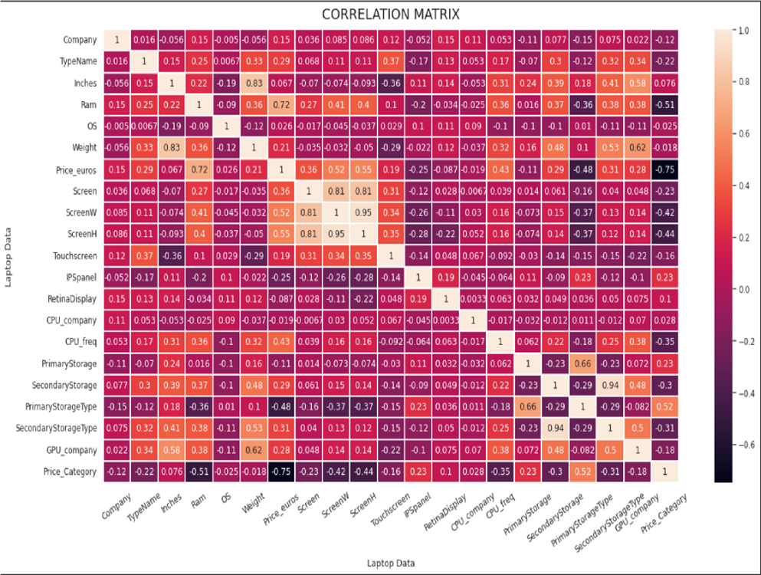
Correlation Matrix and Heatmap:

Slide 7
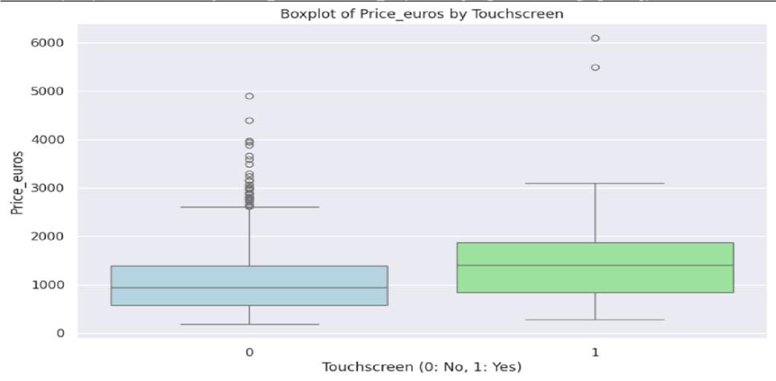
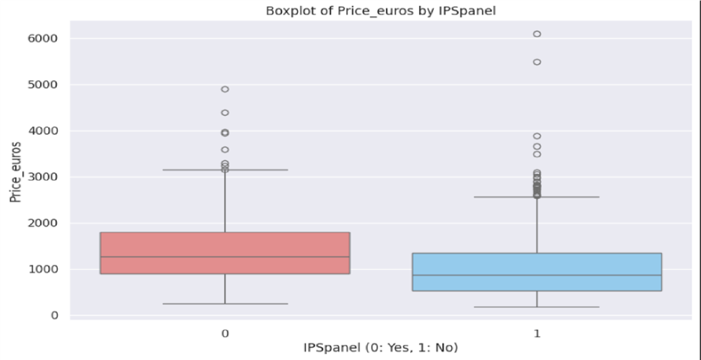
Visualizations
The boxplot shows the distribution of laptop prices based on whether they have a touchscreen or not.
The boxplot shows the distribution of laptop prices based on whether they have an IPS panel or not

Slide 8
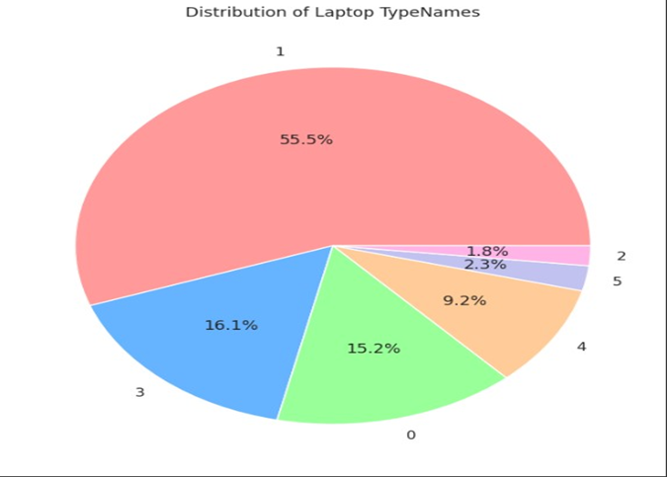
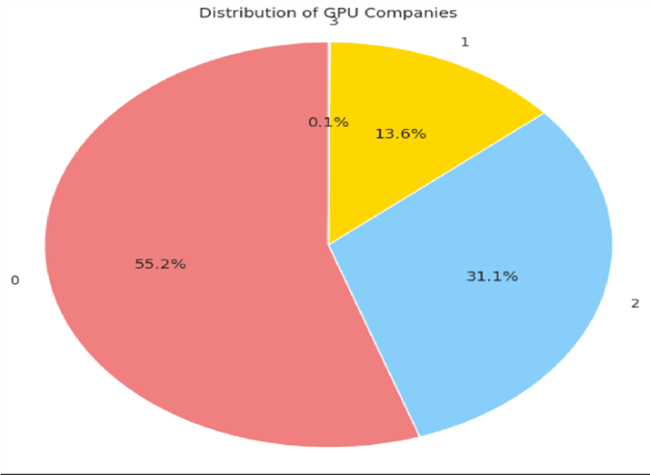
Visualizations
The pie chart visualizes the distribution of laptop Type Names within the dataset where Ultrabook: 0, Notebook: 1 , Netbook:2, Gaming:3, 2 in 1 Convertible:4, Workstation:5
The pie chart displays the distribution of laptop GPU companies within the dataset Where Intel: 0, AMD: 1, Nvidia:2, ARM:3.

Slide 9
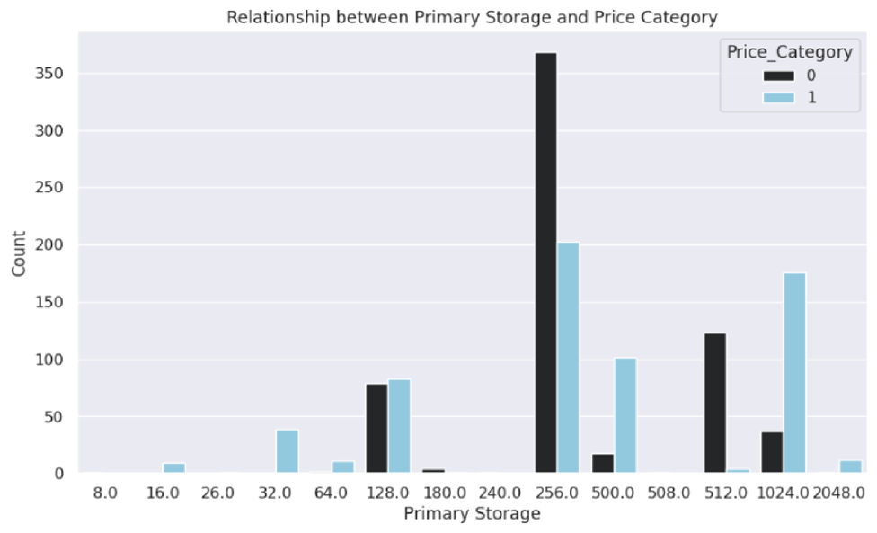
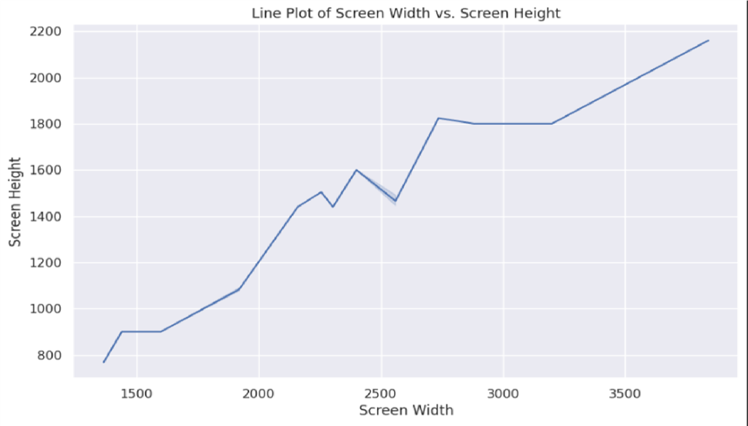
Visualizations
The line plot visualizes the relationship between screen width and screen height in the laptop dataset. It shows the general trend of how screen height changes with screen width.
The count plot visualizes the distribution of the type of primary storage and the price category of the laptops. It shows the number of laptops with different types of primary storage (e.g., SSD, HDD).

Slide 10
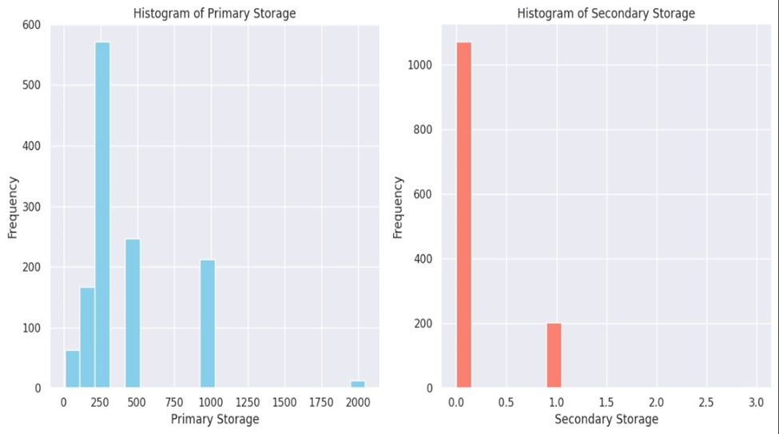
Visualizations
This histogram displays the distribution of primary storage capacities in the dataset. The x-axis represents the primary storage capacity in gigabytes. The y-axis represents the frequency or the number of laptops that have that particular storage capacity. The histogram shows that the majority of laptops in the dataset have a primary storage capacity in the lower ranges (presumably between 0-256 GB, if it's SSD or HDD). A smaller number of laptops have storage capacities in the higher ranges (for example above 512GB).

Slide 11
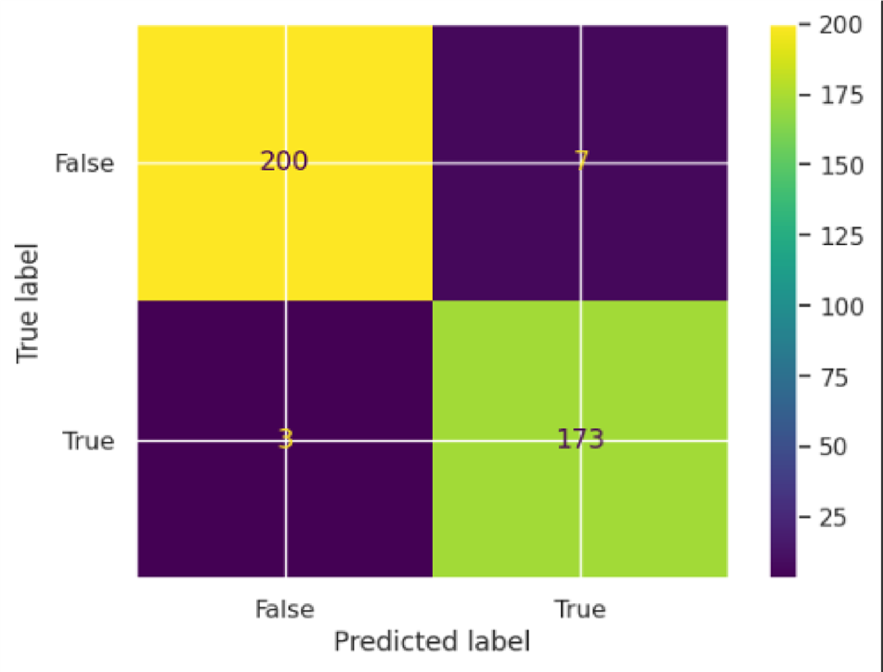
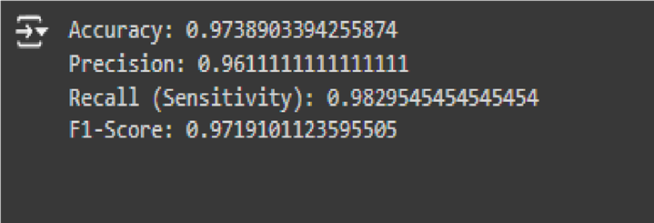
Machine Learning Model
We used Logistic Regression by converting the continuous price into categories: "Low" and "High" based on the median. A new column, Price_category, was created to make the task a binary classification problem. Though this approach sacrifices some precision in price prediction, it simplifies the model and still offers useful insights.
Model Evaluation:
Confusion Matrix: True Positive (173), True Negative (200), False Positive (7), False Negative (3)
Performance Metrics: Accuracy: High – model correctly predicts most categories Precision: High – few false “High” price predictions Recall: High – most actual “High” prices correctly identified F1-Score: High – strong balance between precision and recall
This model effectively classifies laptops into price categories with
reliable performance.

Slide 12


Conclusion
We used Logistic Regression to classify laptops into "Low" and "High" price categories based on their features.
The model performed well,offering useful insights,though accuracy
could improve with advanced models like decision trees or
random forests.
Key Findings:
Processor & RAM are the strongest indicators of price.
SSD storage is linked to higher price categories.
Brand impact: Apple mostly appears in high price; Dell, HP,
and Lenovo vary by specs.
Model Accuracy: Confusion matrix shows strong performance with 200 true
"Low" and 173 true "High" predictions, and minimal errors.
This model helps both consumers and retailers understand how laptop features influence pricing.

Slide 13
Thank you!
Thank you for your time and attention. We hope this project gave you valuable insights into laptop pricing trends. Looking forward to your feedback and suggestions.

